Slide 1

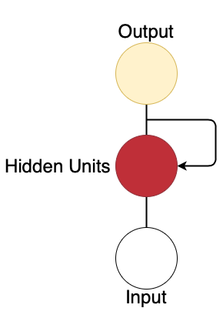

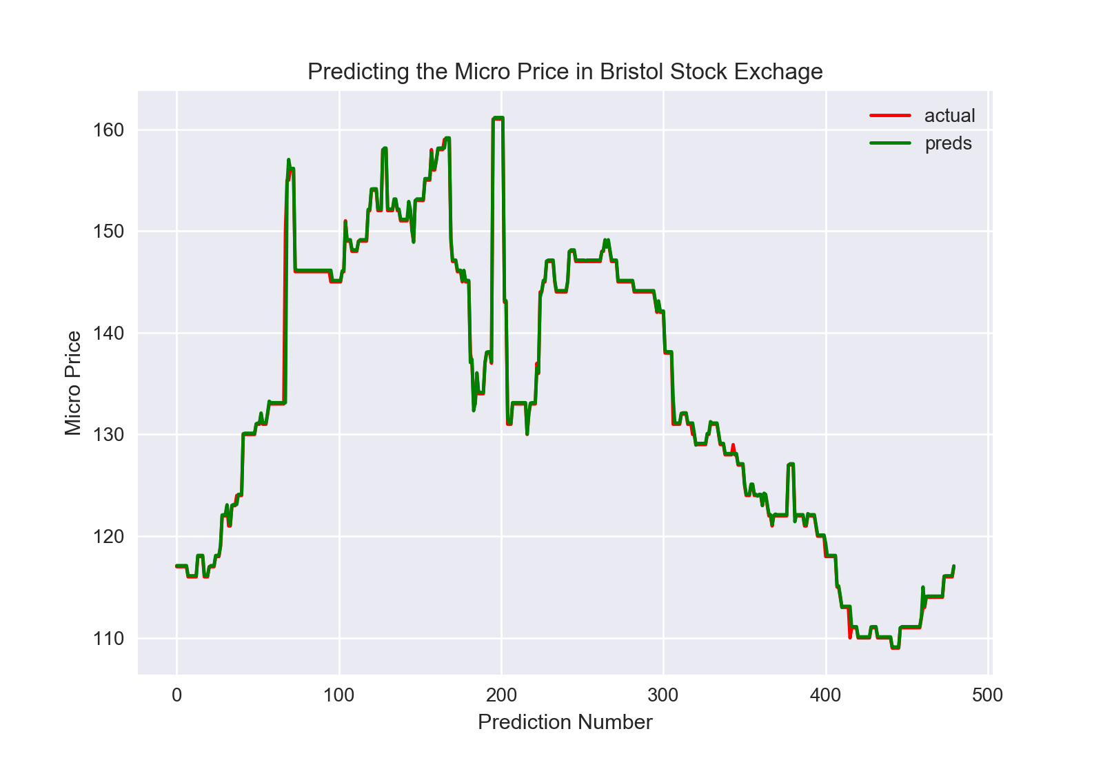
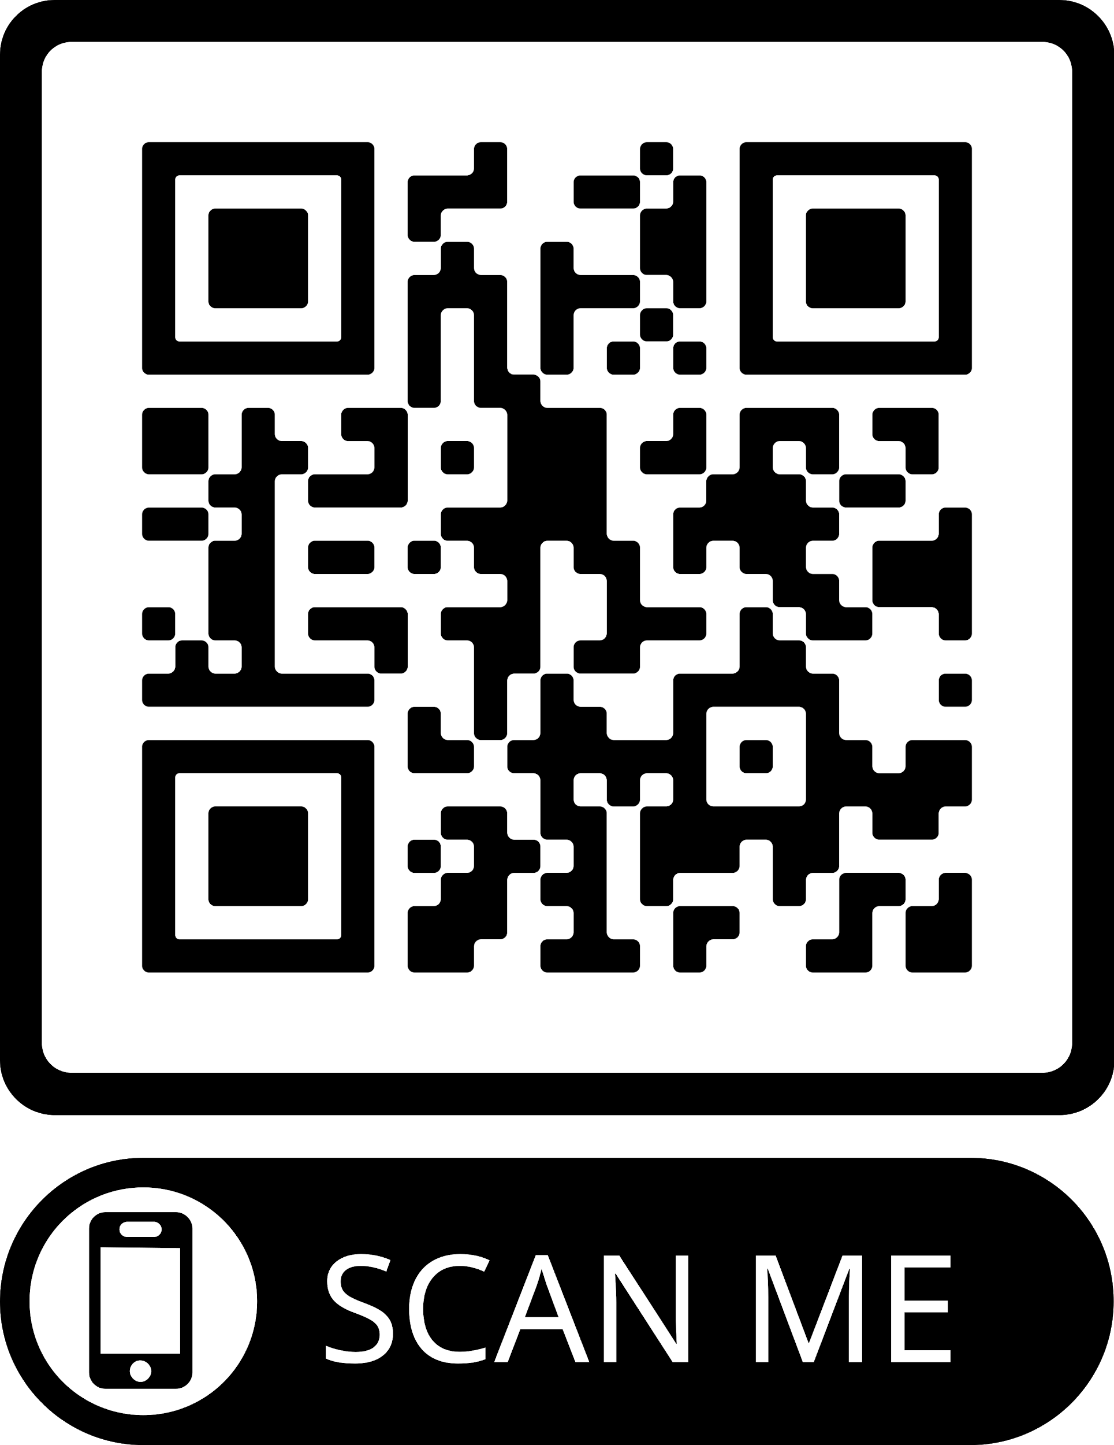

DeepTrader: A Deep Learning Approach For Training An Automated Trading Agent
Aaron Wray, supervised by Pr. Dave Cliff
University of Bristol, Department of Computer Science
Introduction
Over the past 20 years, a number of researchers in industrial and academic research labs around the world have proposed adaptive algorithms for trading, buying and selling in financial exchanges.
Trading algorithms or agents implement specific strategies, and an adaptive algorithm typically uses techniques from statistical machine learning to alter its responses to future market events on the basis of its past experience in the market.
Bids |  | Asks
Quantity | Price | Price | Quantity
3 | £9.30 | £10.90 | 4
2 | £9.00 | £11.00 | 1
2 | £8.50
4 | £7.00
Project Outline
Almost all of the well-known trading algorithms within the public domain use traditional machine-learning or adaptive-control mechanisms and rely on only a small number of observable factors: typically they focus almost exclusively on the history of prices quoted in the market.
This project explores the use of Deep Learning Neural Networks (DLNNs) to train an automated trader to trade on a continuous double auction (CDA) that uses a limit order book (LOB).
A complete LOB provides a lot of information such as of the quantities supplied or demanded at each price, and extended time series information on past bids and offers, which most algorithms tend to ignore. The aim of the project is to utilize all information provided by the LOB to produce a new trader.
The Bristol Stock Exchange (BSE) is an accurate simulation of a CDA-based LOB financial exchange and is used as a test bed for this project.
Limit Order Book
A limit order book is comprised of two halves: a bids half for buyers and an asks (offers) half for sellers for a particular financial instrument.
The table above is a simple diagrammatic example of a LOB.
On the buyers half of the LOB prices are listed in descending order with the highest bid price at the top.
On the sellers half of the LOB prices are listed in ascending order with the lowest ask price at the top.
Project Progress
Using a DLNN taking several time steps as input to predict micro-price of an instrument in the next time step
Using a DLNN taking multivariate data as input to predict the price at which the next trade is going to occur
Using a DLNN taking multivariate data as input to estimate the likelihood of a trade occuring at the next time step.
Recurrent Neural Network (RNN )
The type of DLNN used in this project is a Long Short Term Memory (LSTM) Network, a form of RNN, which contains feedback connections.
The motivation for using an LSTM network is that weights within the network can be shared across time this is useful for the time series data of the LOB and for making more accurate predictions.
Preliminary Results
A common use of RNNs are to predict the movement of a stock price.
The LSTM network takes in the micro price for nine timesteps in the BSE and predicts what the micro price will be for the next time step.
The graph on the right displays the predicted prices with the actual prices during a single trading day in the BSE.

